Slide 1

JavaScript and jQuery Course
Class 15

Slide 2
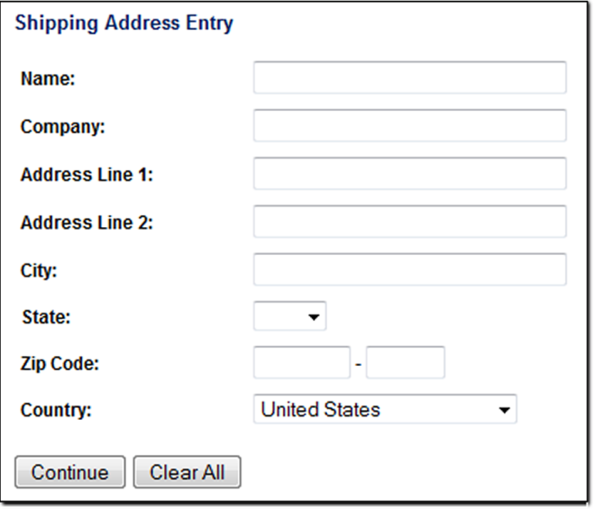

Overview of Forms
Form
form controls / elements
Text boxes
Drop Down list
Buttons
Accept information from users

Slide 3
Two Components of Using Forms
1. The HTML form
-- the web page user interface
2. The server-side processing
sends e-mail
writes to a text file
updates a database
performs some other type of processing on the server

Slide 4
Two Components of Using Forms
The information MUST be processed through a program running on a Web Server
- CGI / PERL - PHP
- ASP / ASPX - TCL
- ColdFusion - the Unix shell
- C/C++ - JSP

Slide 5
HTML form element
<form name=“xyz” id=“xyz”
action=“script “
method= “post or get“
</form>

Slide 6
Text box
<input type=”text"
name=“last_name"
id=“last_name” >
value – what the user enters

Slide 7
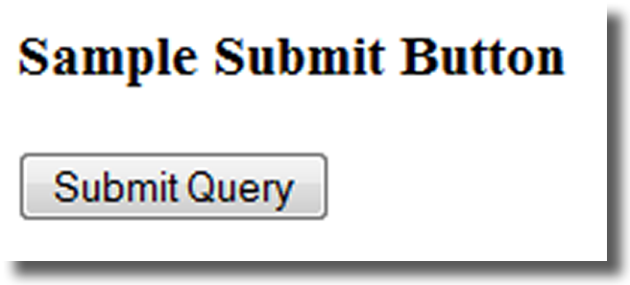
submit button
<input type=“submit>
Submits the form data / calls “action”
Calls the action method of the <form> tag
Sends the form data (the name/value pair for each form element) to the web server.
value = “What it Says!”
default value

Slide 8
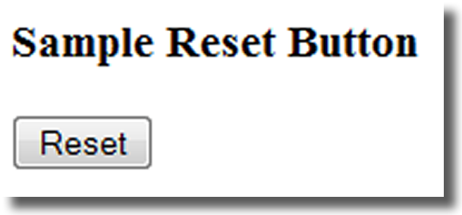
reset button
<input type=“reset”>
Resets the form fields to their initial values
Attributes:
value = “What it Says!”
default value

Slide 9
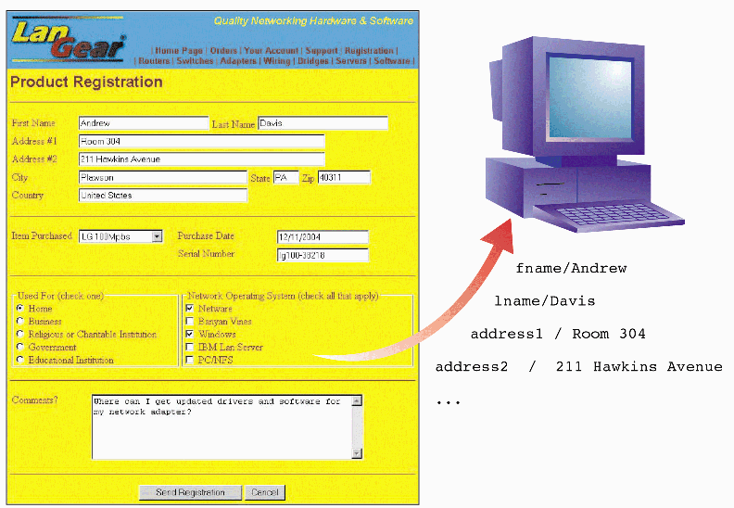
name / value pairs sent to server

Slide 10
Check box
<input type=”checkbox"
name=“name"
id=“id"
value= ‘value“>
‘name’ - for the server
‘id’ - for JS / CSS
‘value’ - the choice

Slide 11
radio buttons mutually exclusive
name MUST be the same – values MUST be different
<input type="radio" name=“xyz" id="id1“ value="value1“ />
<input type="radio" name=“xyz"
id="id2" value="value2“ />
<input type="radio" name=“xyz"
id="id3“ value="value3“ />

Slide 12
Dropdown List
<select name=“job“ id=“job”>
<option value="none">Please select one</option>
<option value ="pgmr” >Programmer </option>
<option value =“dbm">Database Manager </option>
</select>

Slide 13
Label element
<label></label>
Associates a text label with a form control
<label>
Email:
<input type="text" name=“email" id="email">
</label> <label for="email">Email: </label> <input type="text" name=“email" id= "email">

Slide 14
Retrieve Values– val() method
<input type="text" id="name" name="name" >
$('#btn').click(function(){
var theName = $('#name').val();
alert(theName);
}); // end click

Slide 15
Set Values– val() method
<input type="text" id="name" name="name" >
$('#btn').click(function(){
$('#name').val(“teresa”);
}); // end click

Slide 16
Retrieve Values– checkbox
$(':checkbox:checked').val(); // single
$(":checkbox:checked").each( // group
function() {
}); //end each

Slide 17
Retrieve Values– radio
$(':radio:checked').val(); // only one can be checked in the group
$(':radio[name=color]:checked').val();

Slide 18
Retrieve Values– dropdown
<select name=“xyz" id=“xyz”>
</select>
$('select').val();
$(‘#xyz').val();

Slide 19
Form Selectors (filters)
Form related filters
:input $(":input") All input elements
:text $(":text") All input elements with type="text"
:password $(":password") All input elements with type="password"
:radio $(":radio") All input elements with type="radio"
:checkbox $(":checkbox") All input elements with type="checkbox"
:submit $(":submit") All input elements with type="submit"
:reset $(":reset") All input elements with type="reset"
:button $(":button") All input elements with type="button"

Slide 20
Form Selectors (filters)
Form related filters
:image $(":image") All input elements with type="image"
:file $(":file") All input elements with type="file“
:enabled $(":enabled") All enabled input elements
:disabled $(":disabled") All disabled input elements
:selected $(":selected") All selected input elements
:checked $(":checked") All checked input elements

Slide 21
Form methods (events)
val() – retrieve the value
select() - when text is selected in a text area or a text element
change() - when the value of an element (text) has changed
focus() - focus event occurs when the <input> field gets focus
blur() - blur event occurs when the <input> field looses focus
submit() - submit event occurs when a form is submitted

